Slide 1

Our Source

Slide 2
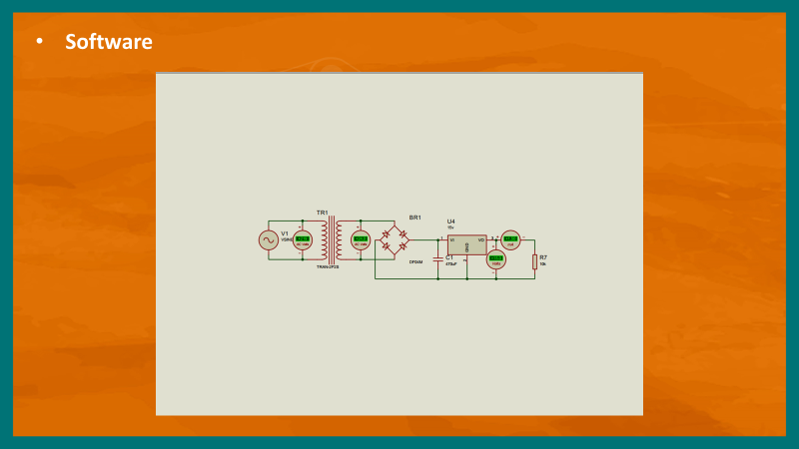

Slide 3
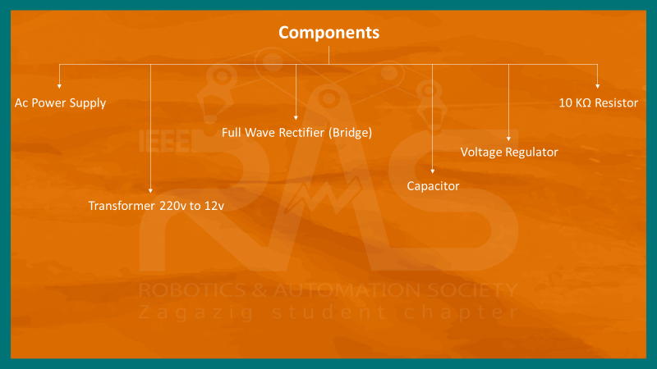

Slide 4
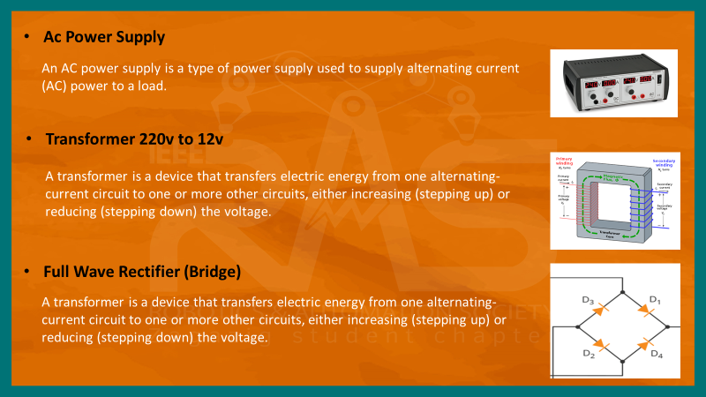

Slide 5
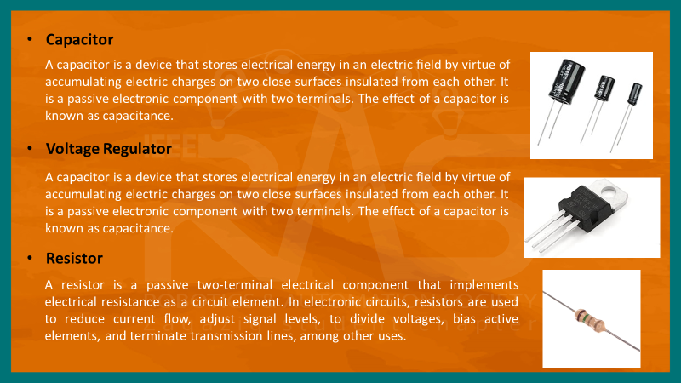

Slide 6
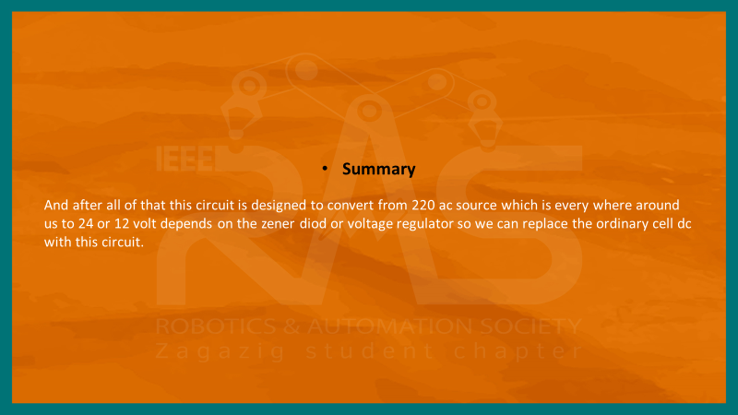

Slide 7

BY : Abdullah Elmasry

Slide 8


Slide 9
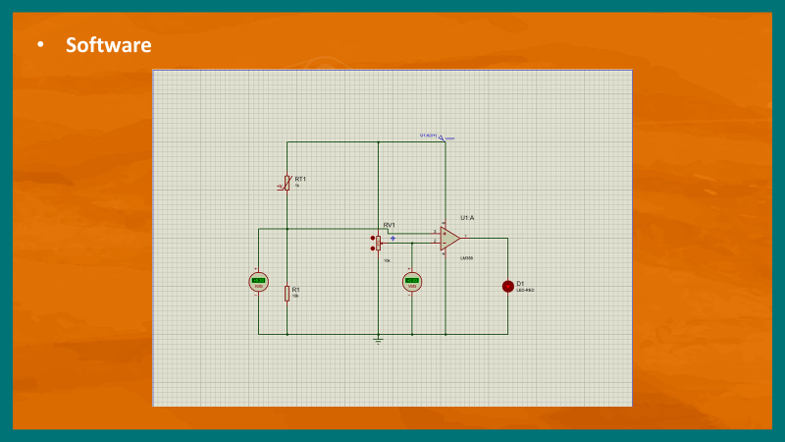

Slide 10
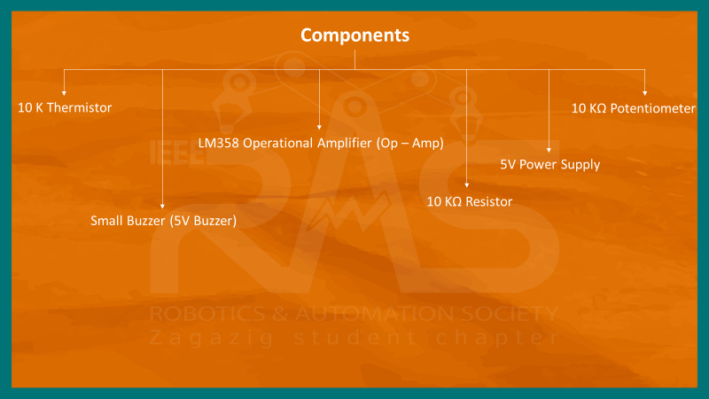

Slide 11
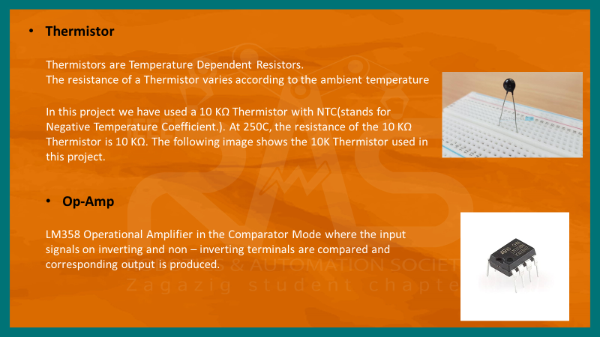

Slide 12
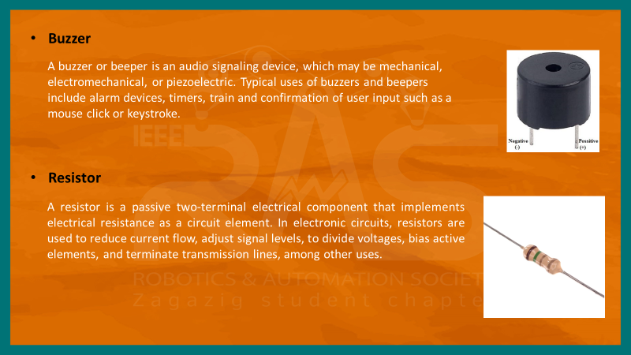

Slide 13
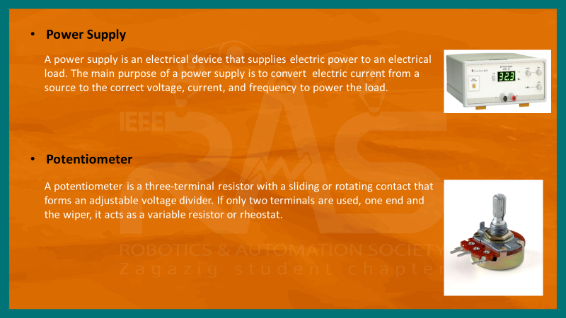

Slide 14

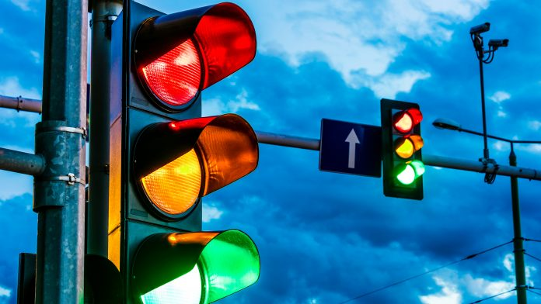
Traffic light circuit

Slide 15
What is a traffic light ?
Traffic light is a machine that regulates traffic in the streets, whether to regulate the directions of cars or to cross pedestrians, and you can imagine the world without traffic lights and how many accidents could happen if there were no traffic lights.
It is very important in our life,So our project is to design a traffic light circuit.

Slide 16
Working Principle:
The working and operation of traffic lights control circuit, the main IC is 4017 counter IC which is used to glow the Red, Yellow and Green LED respectively. The 555 timer acts as a pulse(clock) generator providing an input to the 4017 counter IC.

Slide 17
components
3 Resistors 10K
Capacitor 100uF
LED-Red
LED-Yellow
LED-Green
10 Diodes 1N4007
IC 4017 Counter
IC 555 Timer

Slide 18
Explanation of components:
IC 555 Timer
The 555 timer IC is an integrated circuit (chip) used in a variety of timer, delay, pulse generation, and oscillator application.
It is extremely robust and stable 8-pin device that can be operated either as a very accurate Monostable, Bistable or Astable Multivibrator to produce a variety of applications such as one-shot or delay timers, pulse generation, LED and lamp flasher……
in our project we will use it (Astable Mode) as clock generator where the signal changes from ON to OFF and their time can be controlled by the relationship
T(ON) = 0.693 * (R1+R2) * C
T(OFF) = 0.693 * R2 * C

Slide 19
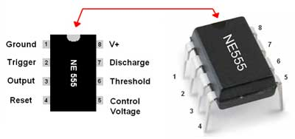
• Pin 1. – Ground, The ground pin connects the 555 timer to the negative (0v) supply .
•Pin 2. – Trigger, The OUT pin goes high and a timing interval starts when this input falls below 1/3 Vcc causing the output to switch from a “LOW” to a “HIGH” state.
• Pin 3. – Output, the output of the integrated circuit and connect to the input of element IC 4017.

Slide 20
• Pin 4. – Reset, This pin is used to “reset” the internal Flip-flop controlling the state of the output, pin 3. This is an active-low input and is generally connected to a logic “1”level when not used to prevent any unwanted resetting of the output.
• Pin 5. –Control Voltage, The control voltage, usually connected to ground via a 10nF capacitor to eliminate any noise.
• Pin 6. – Threshold, The positive input to comparator No 2. This pin is used to reset the Flip-flop when the voltage applied to it exceeds 2/3Vcc causing the output to switch from “HIGH” to “LOW” state. This pin connects directly to the RC timing circuit.
• Pin 7. – Discharge, discharge the timing capacitor to ground when the output at pin 3 switches “LOW”.
• Pin 8. – Supply +Vcc, This is the power supply pin and for general purpose 555 timers is between 4.5V and 15V.

Slide 21
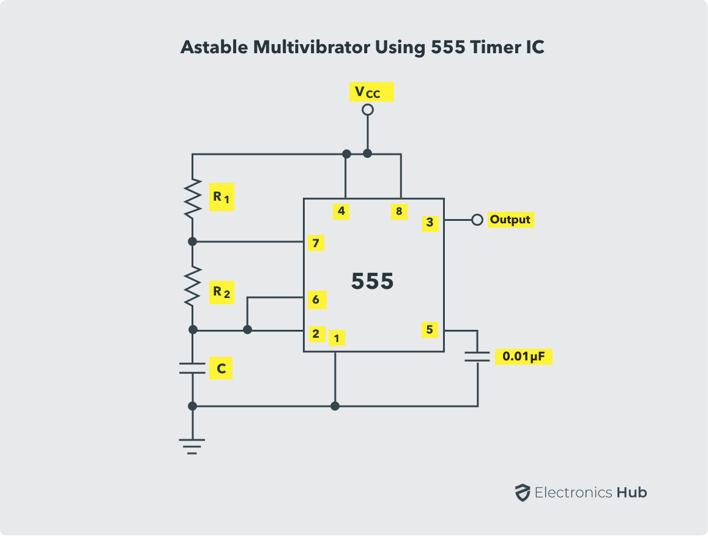
R1=10K & R2=10K & C=100uF
T(ON) = 0.693 * (R1+R2) * C
T(OFF) = 0.693 * R2 * C
SO,
T(ON)= 1.386 sec
T(OFF)= 0.693 sec

Slide 22
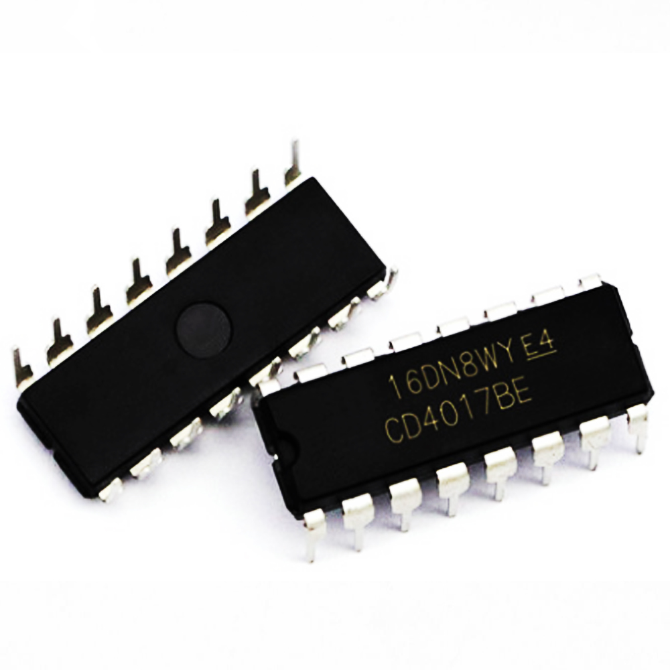
IC 4017 Counter
This IC 4017 is a 16-pin counter IC & it counts clock pulses. It is called a decade counter because it has 10 outputs (Q0 to Q9) and so it can count 10 clock pulses before starting again.

Slide 23
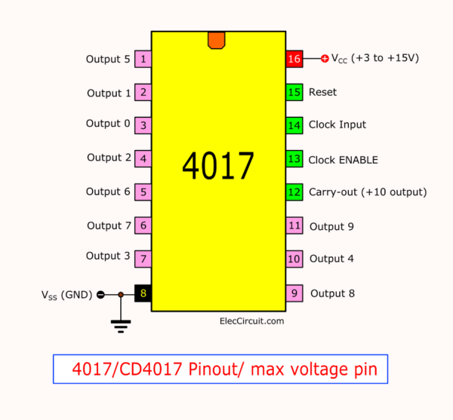
There are 10 outputs pins (1 to 11) labelled Q0 to Q9. There is only ever one and only one output on at a time. Only one of the outputs will be HIGH and all of the other outputs will be LOW.
Pin 12 (carry-out ) is HIGH from Q0 to Q4 and LOW from Q5 to Q9,it can be used to provide the clock pulse for another counter.
Pin 13 clock Inhibit (Enable) we connect it with Ground(Low) as The counter stops counting when the it is HIGH and the outputs do not change.

Slide 24
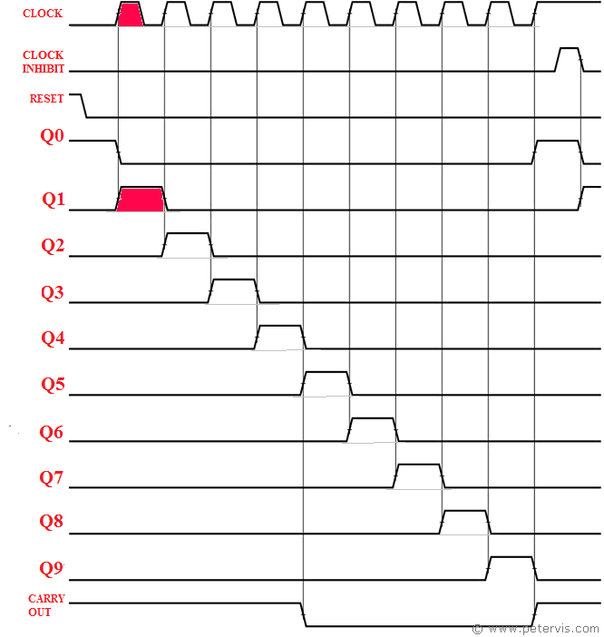
Pin 14 (CLOCK input) it makes the output change each time the clock input goes from LOW to HIGH.
Pin 15 ( RESET) connected to ground. with a HIGH effort, the counter resets to zero (to start from the first).
Pin 16(VCC)

Slide 25
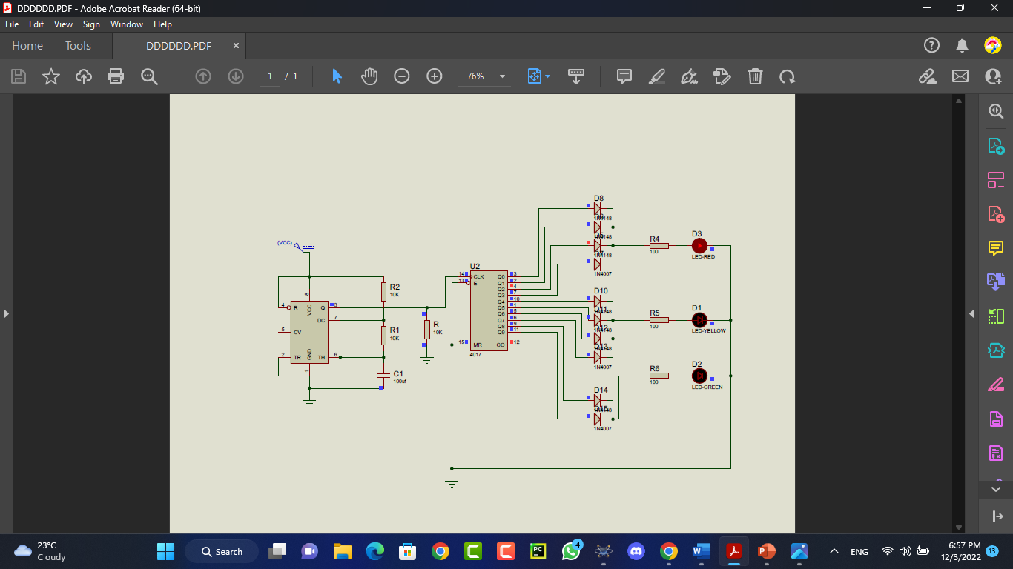
We connect (Q0 to Q9)
With diodes to prevent the flow of current in another direction,
Then we connect our LEDs & put Resistors before them to save them from High current

Slide 26
Benefits from this project
Self-education
Find solutions to problems
Teamwork
Learn new components

Slide 27

BY : SEIF.M

